Slide 1
Dictionaries

Slide 2
Dictionary
Utilize a word to look up its definition

Slide 3
Python Dictionary
Utilize a key to look up its value

Slide 4
Python Dictionary
Like a list but uses the key to index instead of [0, n-1]

Slide 5

Initialize a Dictionary (two ways)
Initialize with values
Initialize empty dictionary

Slide 6
Dictionary
Accessing entries
Adding entries

Slide 7
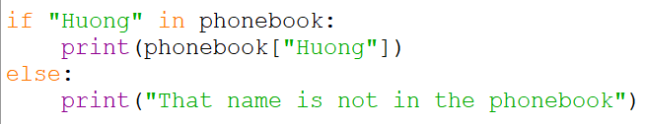
Dictionary
Only access if it’s found
Check for key in dictionary

Slide 8
Dictionary
Deleting entries
Updating entries

Slide 9
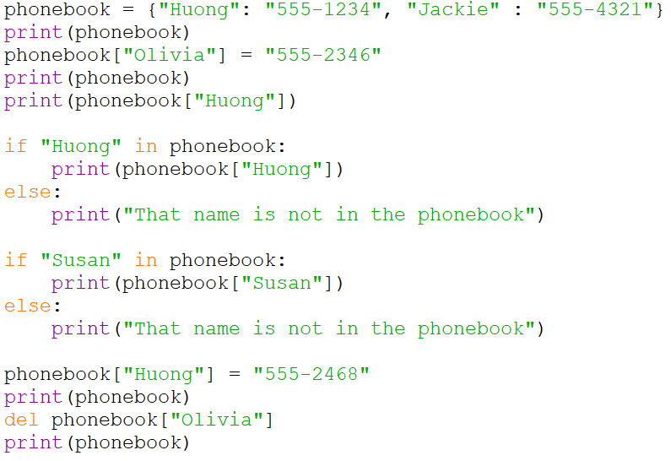
Creating a Phonebook

